Slide 1
Sampling of Analog Signals
Ajit S. Bopardikar
Conexant Systems Pvt. Ltd.
Hyderabad

Slide 2
Recapitulation

Slide 3
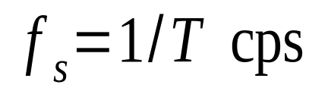
Discrete-Time Signal from Continuous-Time Signal: Sampling
Discrete-time signals are often obtained by sampling continuous-time signals.
Suppose samples taken T seconds apart.
Then sampling frequency is
Question: What should the sampling frequency be?

Slide 4
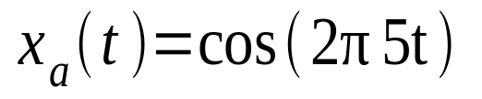
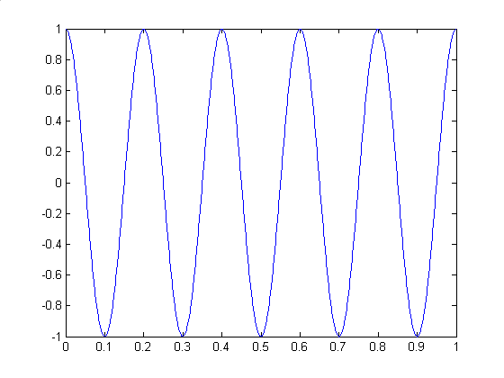
Discrete-Time Signal From Continuous Time Signal: Sampling

Slide 5


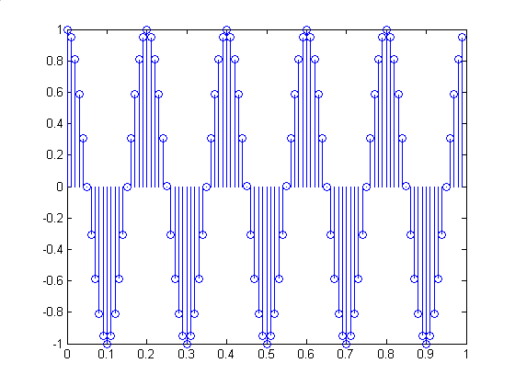
Discrete-Time Signal From Continuous Time Signal: Sampling

Slide 6

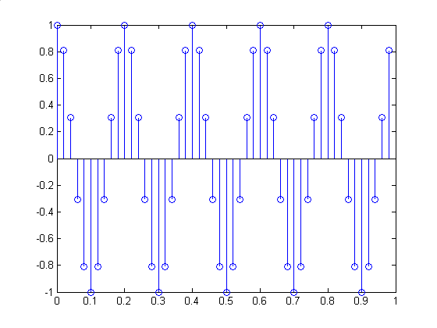
Discrete-Time Signal From Continuous Time Signal: Sampling

Slide 7

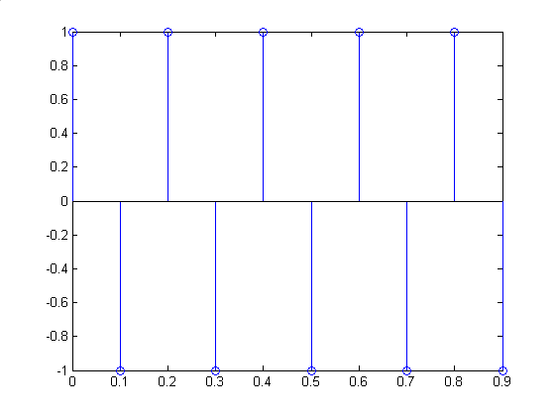
Discrete-Time Signal From Continuous Time Signal: Sampling

Slide 8

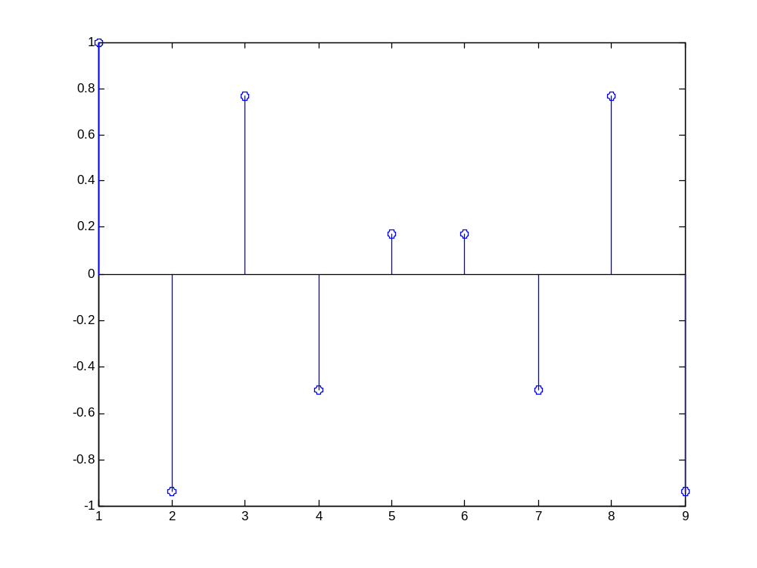
Discrete-Time Signal From Continuous Time Signal: Sampling

Slide 9

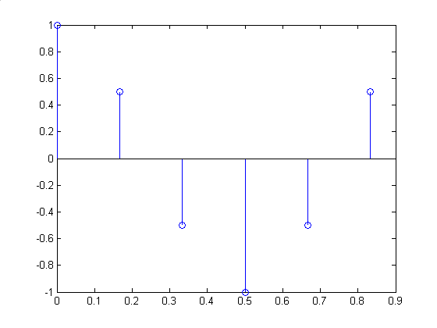
Discrete-Time Signal From Continuous Time Signal: Sampling

Slide 10

Sampling Theorem: First Cut
Critical sampling frequency is twice the frequency of the sinusoid
Once sampling rate is fixed it is typically normalized to 1 for processing the discrete-time signal.

Slide 11





Sampling Theorem: Analog Signal
x(t)‏
t

Slide 12
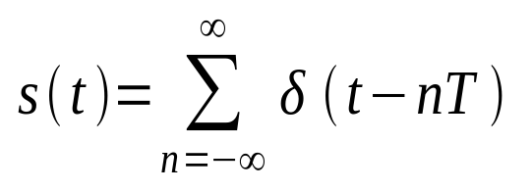
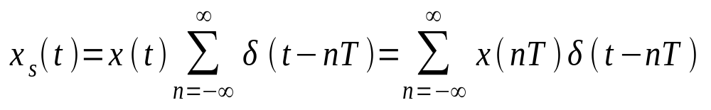
Sampling: Mathematical Representation
Comb Function
The Sampled Function

Slide 13
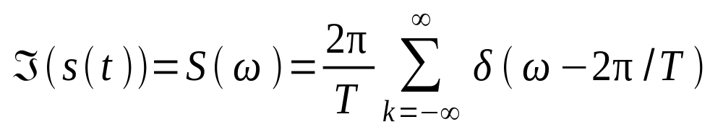






Fourier Transform of Comb Function

Slide 14
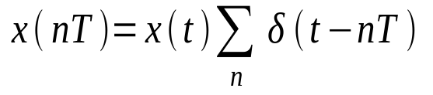
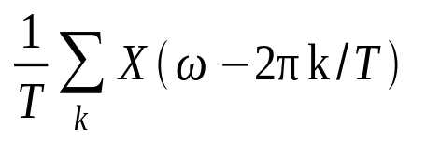


Sampling Theorem: Pictorial Representation
T =1/f_{s}
t
aliasing

Slide 15


Classical Sampling Theorem
To eliminate aliasing, the sampling rate need to satisfy or
A bandlimited signal is completely characterized by it’s samples if the sampling rate is greater than or equal to twice the maximum frequency of the signal.

Slide 16
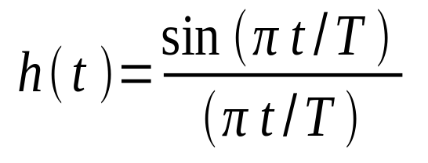
Sampling Theorem: Reconstruction
The signal can be reconstructed using the filter:
Critical sampling

Slide 17
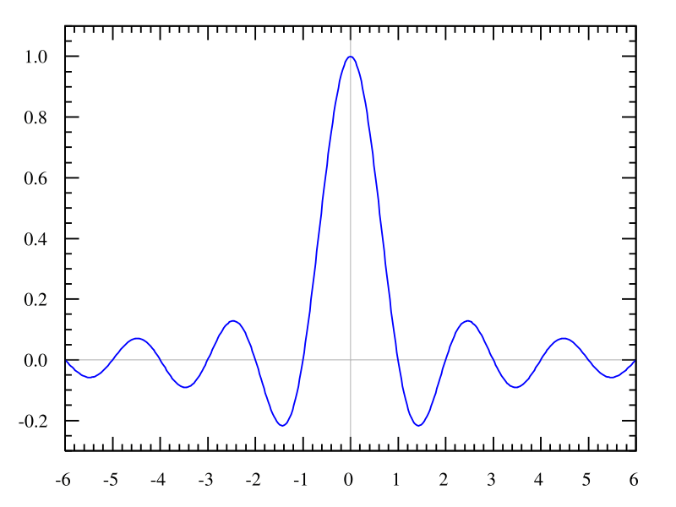
Sampling: Interpolation Filter
Source: http://en.wikipedia.org/wiki/Nyquist%E2%80%93Shannon_sampling_theorem

Slide 18
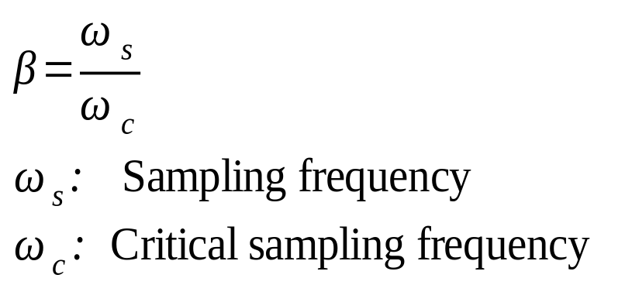
Oversampling: Definition
Sampling a signal at a rate that is significantly higher than the critical sampling frequency
Oversampling factor defined as

Slide 19


Oversampling: Why?
Critical sampling
Oversampling

Slide 20
Oversampling: Why?
Looser tolerances on interpolation/antialiasing filter transition band.

Slide 21
Analog to Digital Conversion
Most natural signals are continuous time, continuous amplitude signals
To be processed by a Digital Signal Processing unit, they need to be discrete-time, discrete-amplitude signals
Analog to digital converters accomplish this

Slide 22
Analog to Digital Process
Sampling: Continuous-time signal to discrete time signal
Quantization: Continuous-valued signal to discrete–valued signal
Coding: Covert-amplitude to a b-bit binary representation
An Analog to Digital Converter (ADC) performs these actions

Slide 23
Quantization
The process of converting a discrete-time continuous amplitude signal to a representation where each sample can be assigned a finite number of bits for representation in digital form
Lossy procedure: Error introduced is known as quantization error/quantization noise

Slide 24


Quantization: Mathematical Representation

Slide 25


Quantization: Example
Original Sampled Signal
Quantized Signal
Quantization step size/resolution
Quantization levels

Slide 26
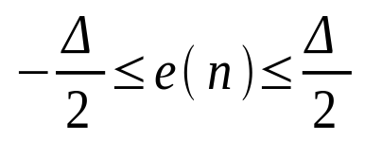
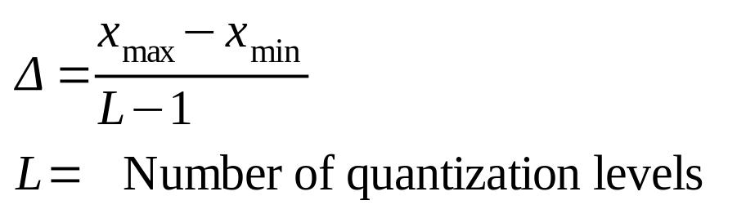
Quantization error

Slide 27
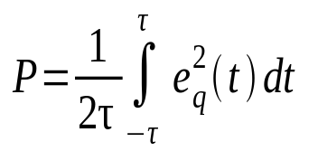

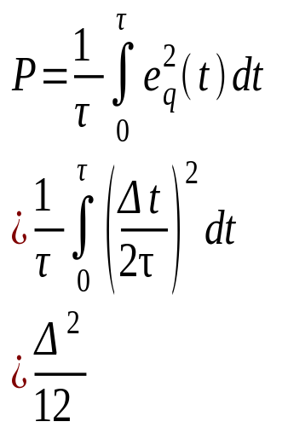


Quantization: Mean Squared Error Power
0

Slide 28

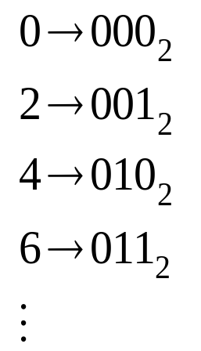
Coding
Convert amplitude to a b-bit binary representation
Suppose quantization levels are 0, 2, 4…
Quantization stepsize is 2 and
Then for coding one can assign

Slide 29
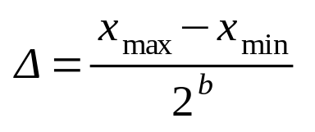
Coding and Quantization
Often, the number of bits is given. Then
Greater the number of bits used, finer is the quantization and more accurate the representation

Slide 30
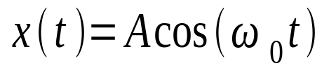
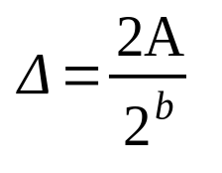
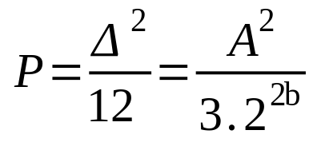
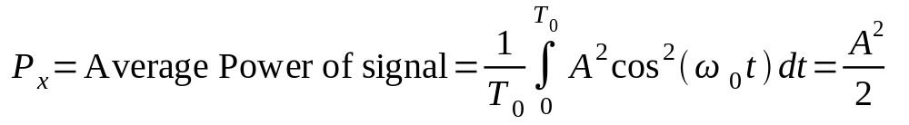
Example: Sinusoid
To quantize a sinusoidal signal using a quantizer with b-bits of accuracy

Slide 31
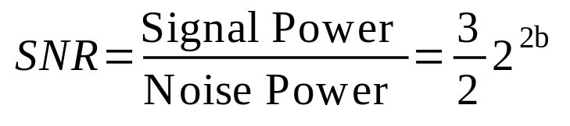
Signal to Noise Ratio (SNR)‏
The SNR improves by a factor of 6.02dB as we increase the number of bits
to quantize a signal

Slide 32
Reading List
Oppenheim, A. V., Willsky, A. S., Young, I. T., “Signal and Systems,” Prentice-Hall, India, New Delhi, 1992.
Oppenheim, A. V., Schafer, R. W., “Discrete-time Signal Processing,” Prentice-Hall, India, 1989.
Proakis, J. G. and Manolakis, D. M.,”Digital Signal Processing: Principles, Algorithms and Applications,” Prentice-Hall, 1996

